Slide 1
Dealing with Big Emotions
Brain Based Strategies to Deal with Stress,
Anxiety and Meltdowns
By Nola Hedstrom-Beblow, BA, BSW, MEd, RCC and
Lori Fender, BEd, MCC

Slide 2
Introductions:
Nola Hedstrom-Beblow and Lori Fender
Certified School Psychologist with SD #23
Registered Clinical Counsellor with a part time private practice (Focus on parenting and interventions for anxiety, depression, ADHD and ASD)
Social Worker for 11 years
20 years experience working with complex children, youth and families
Parent of 2 amazing kiddos
School Counsellor with SD #23
Classroom Teacher for 25 years
Member of Post Critical Incident Response Team with SD #23
Parent of 2 adult children
Notes:
Nola and Lori

Slide 3
The Importance of Dealing with Big Emotions
We first learn to regulate our emotions from caring, attached adults
Research consistently shows that self regulation skill is necessary for reliable emotional well being.
Behaviorally, self-regulation is the ability to act in your long-term best interest
Emotionally, self-regulation is the ability to calm yourself down when you're upset.
Notes:
Nola

Slide 4
Misbehavior vs Meltdown
A misbehavior is easily redirected
Misbehaviour is when the child is fully aware of what he was doing and that he should not have been doing it. And it means it was within the child's capacity to have acted differently. ... In stress behaviour, the child is not actually choosing, but reacting (Stuart Shanker)
Meltdown has nervous system/stress response
Notes:
nola

Slide 5
The Stress Response
What is Really Going On?
Notes:
Lori
-knowledge is power….knowing better leads to doing better
-want to talk to you about the physiological response of our brains and bodies
-when working with children, I teach them the why and how of emotions and the connection between the brain and body

Slide 6
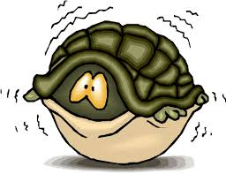
BIG EMOTIONS
Fight / Flight/ Freeze Response
The fight-flight-freeze response is a physiological reaction that occurs in response to a perceived:
      harmful event
      attack
      threat to survival
Notes:
Lori
READ and then go to the next slide to talk about it

Slide 7
FIGHT FLIGHT FREEZE
Fight, Flight Response to Stress. ... It's now called the fight, flight or freeze response. Stress experts around the world are adding the word freeze to the name in deference to the fact that instead of fighting or fleeing, sometimes we tend to freeze (like a deer in the headlights) in traumatic situations.
Necessary for dangerous situations but thoughts can trick us!!
Notes:
Lori
-a survival response that is meant to keep us safe from dangers
-teach children that our feelings are our friends however we often mistakes those more uncomfortable emotions like anger and fear for danger causing us to have the fight, flight , or freeze
-anger, fear, worry/anxiety

Slide 8
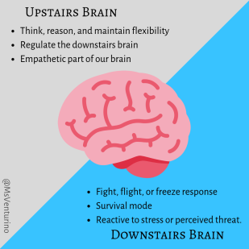
What is Going On?
Upstairs VS Downstairs
BRAIN
Notes:
We need both the upstairs and the downstairs brain. We need that downstairs brain to work. It saves us from urgent situations. It loops our feelings into logical equations. It’s what keeps us breathing! But we don’t want it fully in control. We need the upstairs and the downstairs brain to work together. The staircase is one of the most important parts of a two-story house, and that same logic is true for the brain. When the brain’s staircase is built, the upstairs brain can monitor the strong emotions and impulses from the downstairs and make sense of them. KIDS NEED HELP WITH THIS!!!

Slide 9
Upstairs vs. Downstairs Brain
The downstairs brain is the reptilian or survival part of the brain that acts out of instinct. This is the area of the brain responsible for breathing, blinking, fight or flight reactions, and the big emotions like anger or fear.
The thinking brain or learning brain controls higher-order thinking such as imagining, planning, decision making and analytical thinking.
When the thinking brain is functioning well, one can regulate emotions and think before acting
Notes:
The reptilian brain is the old or survival part of the brain that acts out of instinct. This is the area of the brain responsible for breathing, blinking, fight or flight reactions, and the big emotions like anger or fear.
The thinking brain or learning brain controls higher-order thinking such as imagining, planning, decision making and analytical thinking.
When the thinking brain is functioning well, one can regulate emotions and think before acting

Slide 10
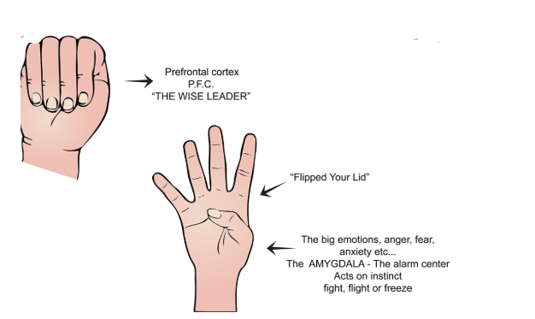
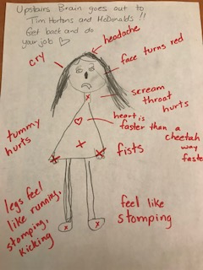
Hand Model of the Brain
Notes:
Lori
Upstairs brain or our wise leader goes out for a coffee to starbucks or to the playground….

Slide 11
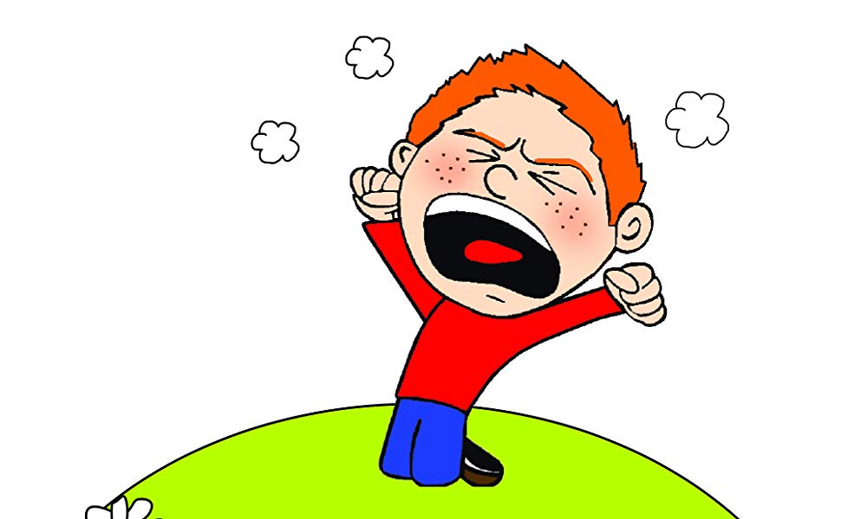
Flipping Your Lid
the amygdala takes over and blocks access to the upstairs thinking, reasoning higher-order brain. The child’s ability to think clearly is compromised.
During this time, children often require adult support to calm themselves because the rational part of the brain is overwhelmed by emotion.
Strategies during this time should include co-regulation and empathy and limited language.
Notes:
lori

Slide 12
What Do We See?
As we get more upset, our thinking becomes more rigid (I am right!/I hate you!/I am stupid!)
Defensiveness/Defiance/Anger/Hitting/Yelling/Hiding
Rigid stance/flushed/fast breathing
No sense of humour, less creative
Ability to process language decreases
Talk faster
Sweating
Head banging
Shutdown
Notes:
Nola and lori
Watch for these signs in our children ….even in our spouse or ourselves
We teach the body and brain connection to children.
Important that we recognize the stress response in ourselves as well

Slide 13
What Big People Need to Know
Notes:
nola

Slide 14
Being With Big Emotions –Video
Notes:
nola

Slide 15
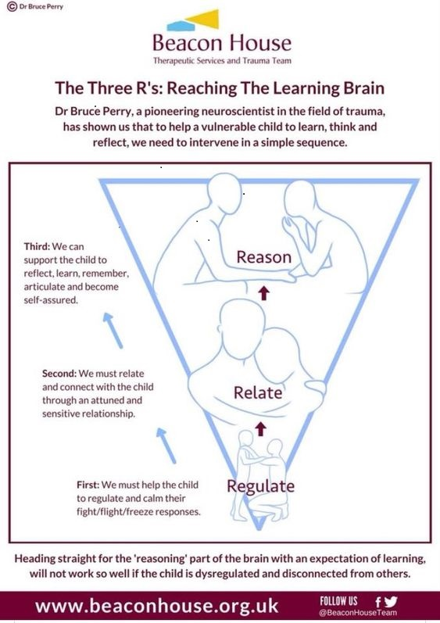
Regulate Through Connection
Notes:
Nola??? Did we want to remove this one since it duplicates the video
I would like to keep it….as it is good visual they can have

Slide 16
Be a Detective
Create connection
Is your child overwhelmed, tired, hungry?
Do they have the skills to complete the task?
Children require external guidance and implementation of everyday routines (do with, prompt)
Practice / repetition of skills when regulated
Start with the end in mind
Promote generalization of skills and provide feedback
Notes:
No I will explain all these

Slide 17
Child Development
https://www.youtube.com/watch?v=rR5siY0cops
Notes:
Nola

Slide 18
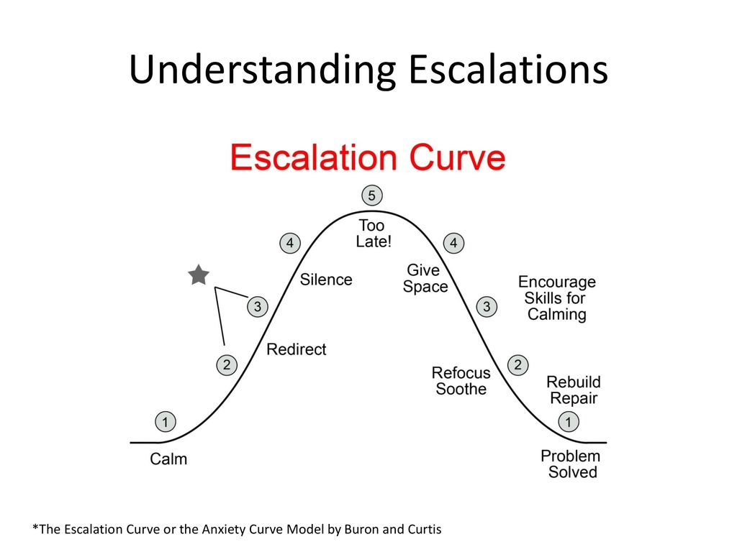
Notes:
nola

Slide 19
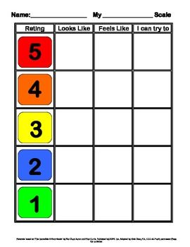
Linking: Thinking, Feeling, Behaviour….
Notes:
nola

Slide 20

What Kids Need to Know

Slide 21
Understanding Big Emotions
Children must map or understand their emotions
If a child cannot read their emotions, they will not able to accurately read others
Big emotions change thinking
Big emotions cause panic
The panic causes our thoughts and feeling to get BIGGER!
Co regulation leads to self regulation-that means that adults role is essential (connection, support, modeling)
Name it to tame it!
Know what it is like to feel calm and that feeling do pass
Practice when calm
Notes:
nola

Slide 22
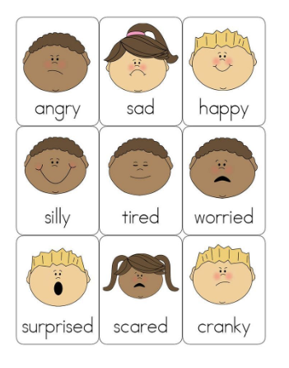
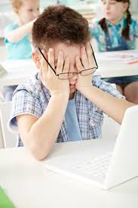
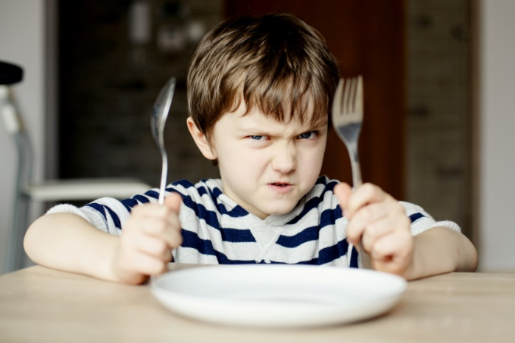
Feelings and Sensations in the Body
Notes:
nola

Slide 23
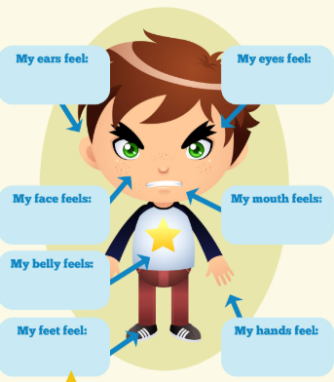
Brain and Body “Expected” Responses
Thinking changes
Feeling changes
Pounding heart
Stomach feels sick or
“butterflies”
Difficulty breathing
Feel hot or cold
Face turns red
Shaking / Feel dizzy
Feel “unnatural”
Pupils dilate
Chemicals in your body change(Glucose/cortisol/aadrenaline)
Notes:
lori

Slide 24
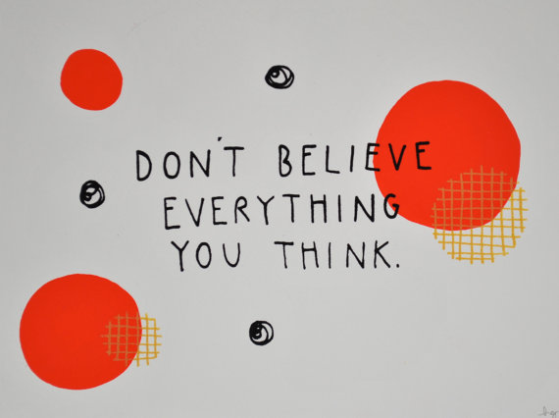
Notes:
Lori
I can talk to how I work with kids regarding this quote
Red thoughts/green thoughts/ challenging their thoughts/ the worry/amygdala highjacker bully

Slide 25
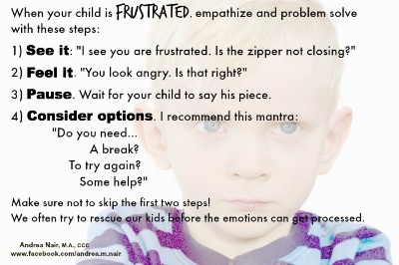
Notes:
examples

Slide 26
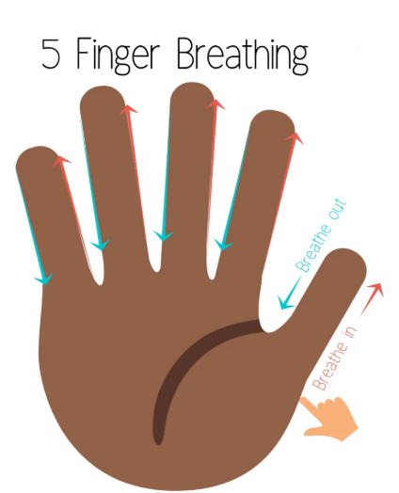
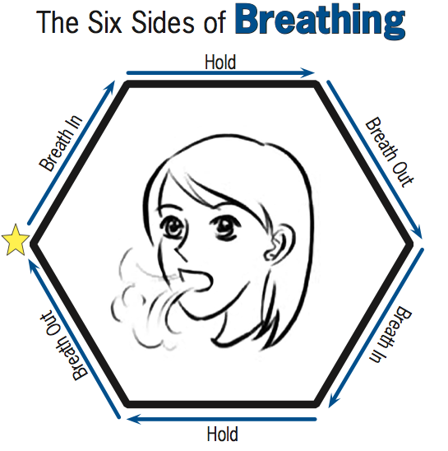
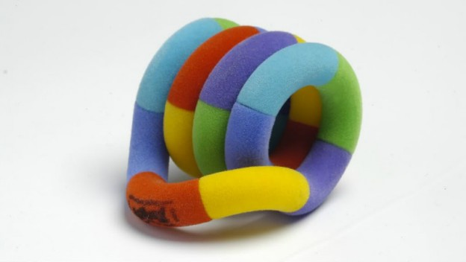

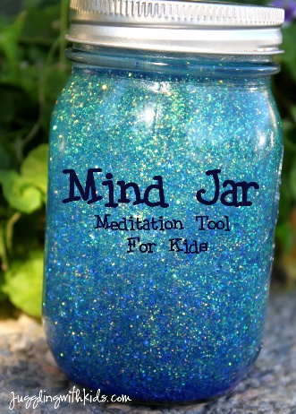
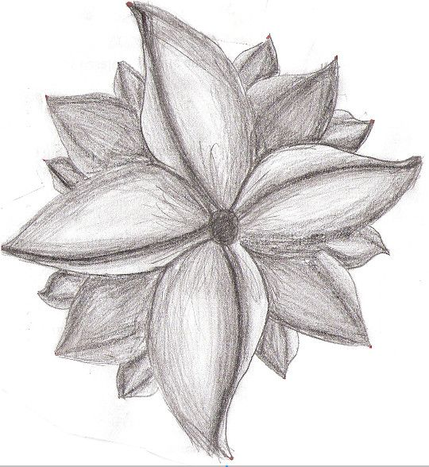

Simple Tools and Visuals
Notes:
Lori and nola

Slide 27
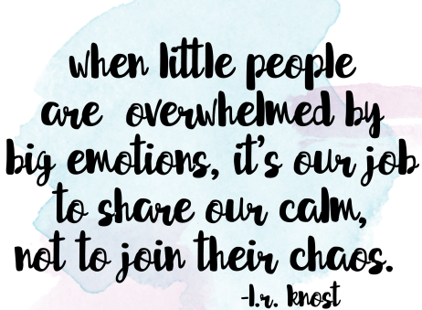

Slide 28
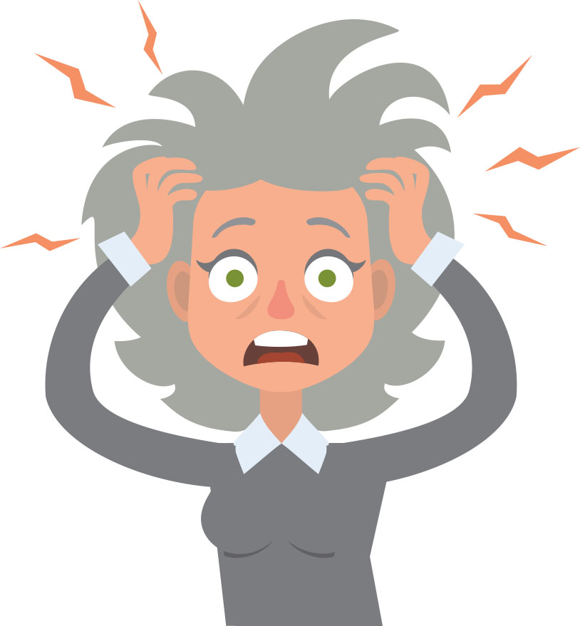
Know Yourself and Your Stressors

Slide 29
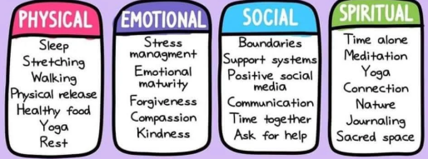
How Do You Take Care of You???
Notes:
Lori – I can do this piece.
HALT acronym as well ….
Practice mindful and self care strategies-train your brain and body
Notice your bodies reactions to stress and conflict and implement strategies at that time
Problem solve (combat cognitive rigidity)
Sleep
Exercise
Drink water/eat
Find joy
Connect !!!!

Slide 30
RESOURCES
Raising a Secure Child by Kenneth Hoffman
Rest Play Grow by Deb McNamara
Positive Parenting by Rebecca Eanes
Hold Onto Your Kids by Dr. Gordon Neufeld
Parenting With Love and Logic by Foster W. Cline
The Conscious Parent by Shefali Tsabary
Between Parent and Child by Haim G. Ginott
The Whole Brain Child by Daniel J. Siegel
The Opposite of Worry by Lawrence J. Cohen
Anxious Kids, Anxious Parents by Lynn Lyons and R. Reid Wilson
Blogs/Websites
The Neufeld Institute
Parenting From The Heart
Nurture and Thrive – Parenting and Child Development
Positive Parenting Solutions
Aha! Parenting
The Daily Parent

Slide 31
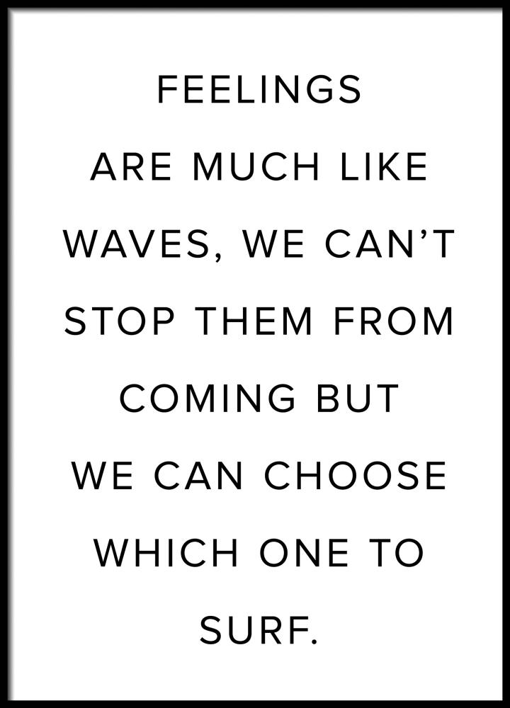
Questions …
Notes:
closing

